Slide 1
Facial Expression Recognition (FER) with FER+ AIT 736 Final Project
E. Beqari, G. Brensike, B. Tran
May 03, 2021

Slide 2
Agenda
Introduction and Motivation
The Dataset
Data Preprocessing
Feature Engineering
Dimensionality Reduction
The Models
Support Vector Machine (SVM)
eXtreme Gradient Boosted Trees (XGBoost)
Convolutional Neural Network (CNN)
Conditional Variational AutoEncoder (CVAE)
Voting Ensemble
Results

Slide 3
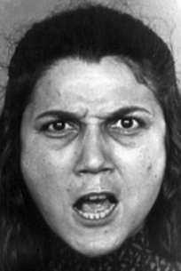

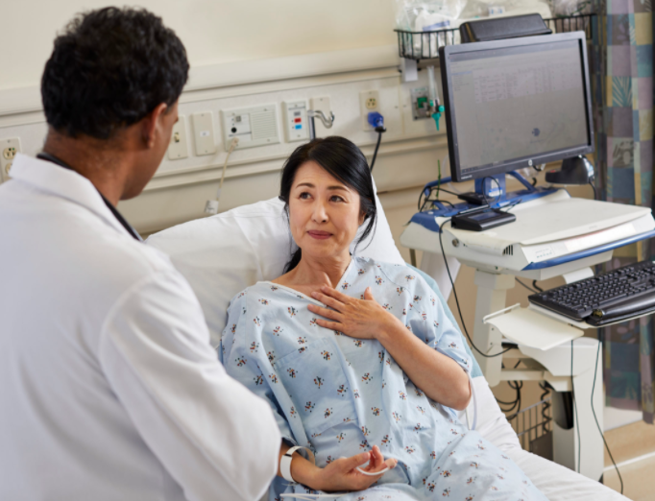
Introduction and Motivation
Input Image
Prediction
Facial Expression Recognition (FER) is a machine learning task that attempts to classify human emotions based on facial expressions in still images or video.
Applications include, but are not limited to:
Marketing ¹
Detect Buys Intent
Product Satisfaction
Medicine ²
Detection of Neuropsychiatric Disorders
Automated Pain Detection
ML Model
Angry
¹ G. Shergill, O. Diegel, A. Sarrafzadeh, and A. Shekar. “Computerized Sales Assistants: The Application of Computer Technology to Measure Consumer Interest–a Conceptual Framework”. Journal of Electronic Commerce Research, 2008
² C. Kohler, E. Martin, N. Stolar, F. Barrett, R. Verma, C. Brensinger, W. Bilker, and R. Gur. “Static Posed and Evoked Facial Expressions of Emotions in Schizophrenia”. Schizophrenia Research, 2008.

Slide 4
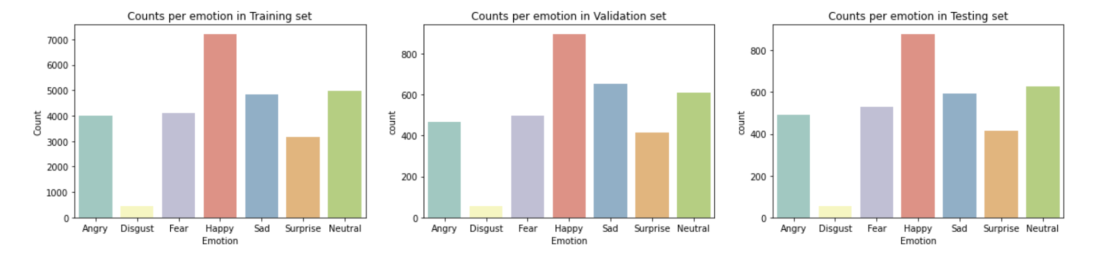
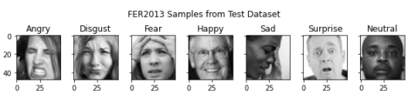
The Dataset FER-2013
Class Distribution
The dataset we selected to train and validate our models is the FER-2103 set.
Dataset consists of 35,685 grayscale images that are 48x48 pixels and were partitioned into the following sets:
Training Set: 28,709 images used for training models
Public Test: 3,589 images used to test during training
Private Test: 3,589 images used for the final validation of the model
Each image is labelled with one of seven different emotions.

Slide 5
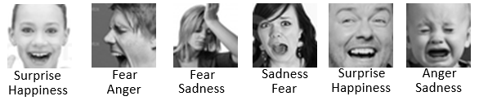

The Dataset FER+ Augmentation
After a few attempts at training a model with high accuracy our team found that many of the labels in the FER—2013 set did not appropriately match the image. We determined this to be a main reason for our lower accuracies.
FER+ or FERPlus is an augmentation of the FER-2013 and was generated by having 10 humans relabel each image. The FER+ dataset contains the raw vote counts for each label. Our team used the Argmax of the votes as the new label for the images.
Sample Mislabeled Images
FER-2013 Label
FER+ Label
10
New Labeling Scheme
8
6
Angry
Labelers Vote
4
2
Anger
Fear
Sadness
Happiness
Surprise
Disgust
Neutral

Slide 6
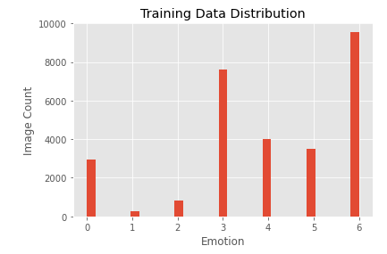
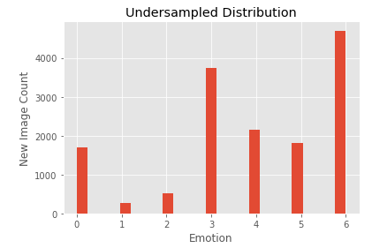
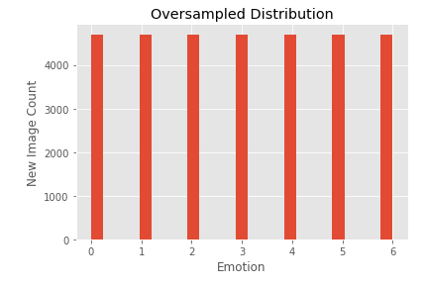
Data Preprocessing Under and Oversampling
Due to the unbalanced nature of the classes our team attempted to improve model performance by using Under Sampling, for overrepresented classes, and Oversampling, on underrepresented classes.
Under Sampling: We used a One-Sided Selection technique for under sampling which uses Tomek Links and a Condensed Nearest Neighbors (CNN) algorithm to remove datapoints³. This type of under sampling will attempt to remove observations that below to the overrepresented classes and whose nearest neighbor is from another class.
Oversampling: We utilized the Synthetic Minority Oversampling Technique (SMOTE) which generates new samples for underrepresented classes so we get a more balanced set⁴.
Under and Oversampling actually decreased our accuracy so we dropped it!
³ J. Brownlee. Undersampling Algorithms for Imbalanced Classification, 2020
⁴ J. Brownlee. SMOTE for Imbalanced Classification with Python, 2020

Slide 7
Data Preprocessing Pixel Normalization and Unwrapping
Pixel Normalization
For our CVAE and CNN models we divide all the pixels values by 255 to normalize them.
Pixel Unwrapping
The SVM and XGBoost libraries do not natively support sending images to a model. This required the team to reformat the pixels for each image before sending to a model for training and predicting.
In order to accomplish this, we simply reshaped the image pixels using the built in NumPy functions.
We did not normalize the pixels by dividing by 255 since both models will use Principal Component Analysis (PCA) to reduce the dimension which is already normalized.

Slide 8
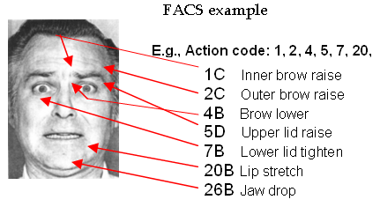
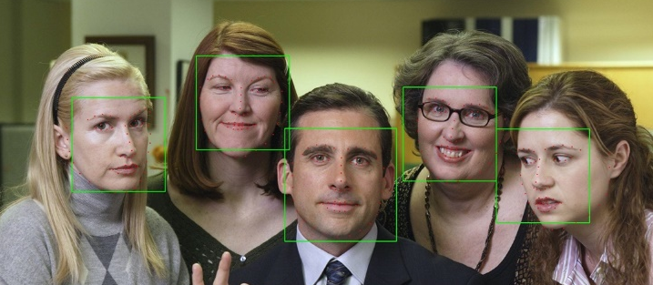
Feature Engineering DLib Face Landmarks
All facial expressions can be broken down into individual components of muscle movement called Action Units (AU) described in the Facial Action Coding System (FACS)⁹.
This motivated our team to try and engineer features from the images to capture key facial features, or landmarks, to help classify the emotions expressed in the facial AUs we detect.
To enable out team to capture the facial landmarks we utilized the DLib library.
To extract the landmarks, we first detect all faces in the image using the frontal face detector and then we get the landmarks using the shape predictor.
The shape predictor uses a set of pre-trained weights and returns a group of 68 points for each face detected in an image which we will use as new features in our prediction models.
⁵ Ekman. Facial Action Coding System.

Slide 9

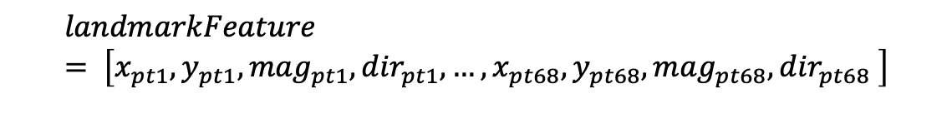
Feature Engineering DLib Face Landmarks cont.
In addition to the 68 x and y values of each facial landmark we also compute the magnitude of each point as well as direction or bearing to the midpoint of the face.
This led to our final landmark feature set as the following.
$$landmarkFeature= \left[x_{pt1}, y_{pt1},{mag}_{pt1},{dir}_{pt1}, …,x_{pt68}, y_{pt68},{mag}_{pt68},{dir}_{pt68} \right]$$
Dimension = [1, 272]
⁵ Ekman. Facial Action Coding System.

Slide 10
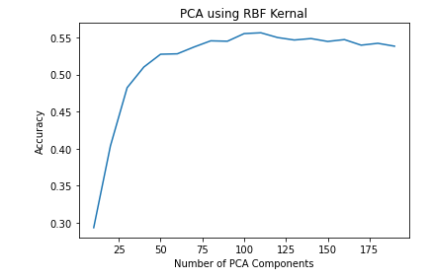
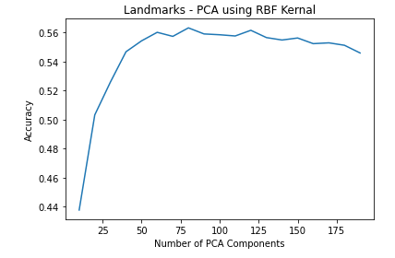
Dimensionality Reduction Principal Component Analysis (PCA)
After processing our input data for our SVM model and creating our new training features, our team decided use PCA to reduce the dimensionality of the reshaped pixel data and facial landmark features which are sent to the SVM model.
All other model’s performance decreased when we eliminated features, but SVM in particular got better so we applied PCA to all data sent to this model.
In order to determine how many components to use we ran a loop that considers 10-200 components and we select the one with the best performance.
Optimal = 110
Optimal = 80

Slide 11
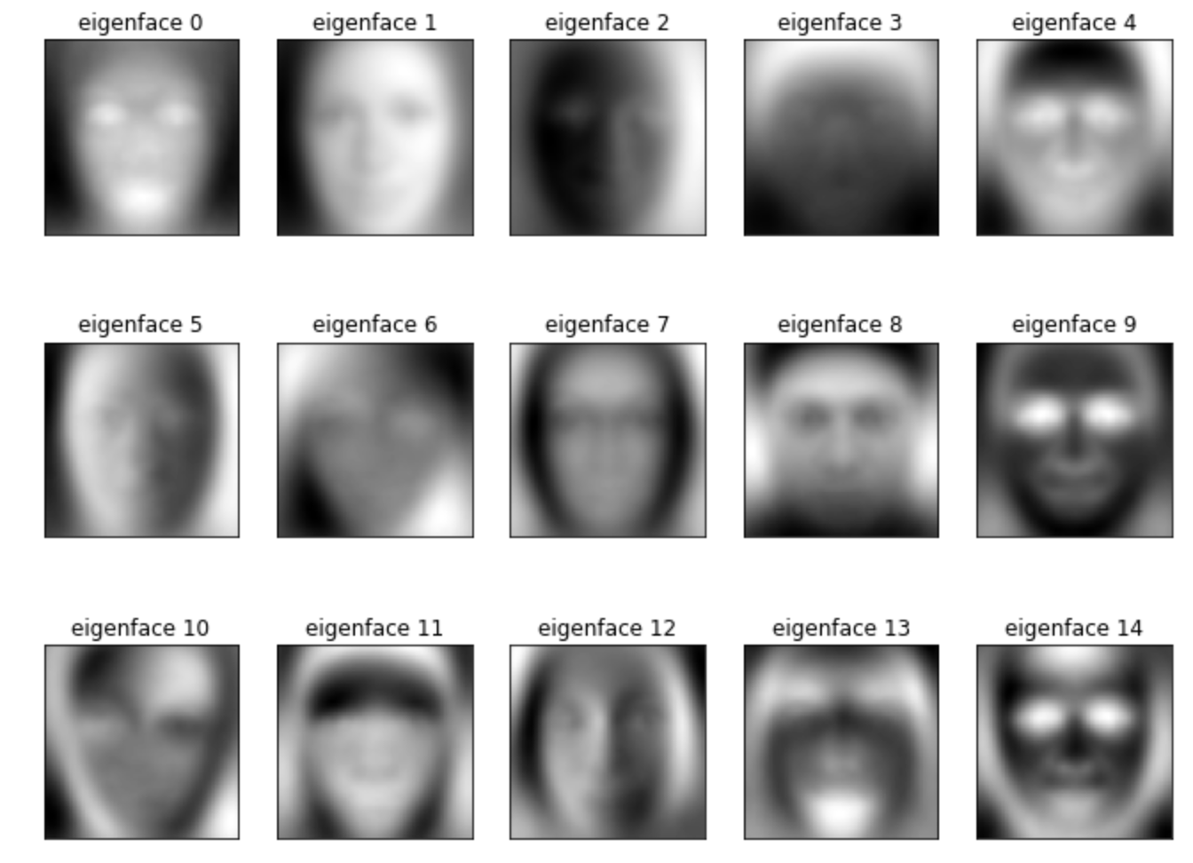
Dimensionality Reduction Principal Component Analysis (PCA) cont.
The resulting eigenvectors that make up PCA components can be visualized in what we call Eigenfaces.
These eigenfaces can be combined to represent any face in our dataset similar to the eigenvalues in a non-image based problem.
Sample of 15 of 110 Eigenfaces
…and yes they are very creepy!!!

Slide 12
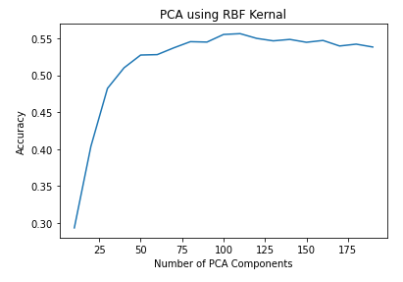
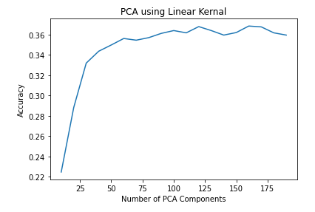
Model 1 SVM
As we learned in class a Support Vector Machine (SVM) can be a very effective classification model even in a complex multi class problem such as ours.
We utilize it here to train two models, one on the pixel dataset and one using the landmark feature set.
Our team considered two kernels for the SVM namely the Radial Basis Function (RBF) and the Linear during our PCA tuning process.
Although under and oversampling did not work for our models, using the class_weights argument set to ‘balanced’ did improve our performance. The balanced value will weight each class inversely related to its prevalence in the dataset and help in our unbalanced set.
RBF Wins!!

Slide 13

Model 2 XGBoost
eXtreme Gradient Boost (XGBoost) is an ensemble method which implements gradient boosting with decision trees.
It is optimized for speed as opposed to AdaBoost which we learned in class.
XGBoost is also more tolerant to including weak predicting features which is is one reason we did not use PCA on data sent to XGBoost for training.
Not much tuning was needed for this model with the exception of selecting the proper objective and evaluation metric for our type of problem, which were multi:softprob and mlogloss respectively. Similar to SVM, we created two XGBoost models using the landmark features and pixel datasets.

Slide 14
Model 3 CNN
Convolutional Neural Networks (CNN) are known to be an effective type of model for creating image-based classifiers.
Basic Block Structure: Convo2d → BatchNorm → Convo2D → MaxPool → DroupOut (Repeated x4)
Adam optimizer with an initial learning rate of 0.001.
Reduce Learning Rate Callback: Reduce learning rate by a factor of 0.2 if accuracy does not improve for 3 epochs.
Early Stopping Callback: Stop training if our loss metric didn’t improve for any epoch.
CNN Network Architecture

Slide 15
Model 4 Classifier-Conditioned Variational Autoencoder
Variational Autoencoder (VAE) is a is neural network architecture constructed primarily to learn data coding – typically in an self-supervised setting. The codings are input data representation in lower dimensions. VAEs build up on two statistical concepts called Variational Inference and Representation Learning.
Advantages | Disadvantages
1) Learn smooth latent representation of input learn what noise to leave out of the codings 2) Give representations with disentangled factors 3) Efficient dimensionality reduction framework 4) Implements a Gaussian prior which allows it to be trained with back-propagation 5) Gaussian modeling allows each factor to push itself further apart from other factors 6) Proposed as scalable variational inference in general on large datasets | 1) Unlike sampling-based methods, variational approaches will almost never find the globally optimal solution 2) As a generative model a significant drawback is the lossy outputs they generate

Slide 16
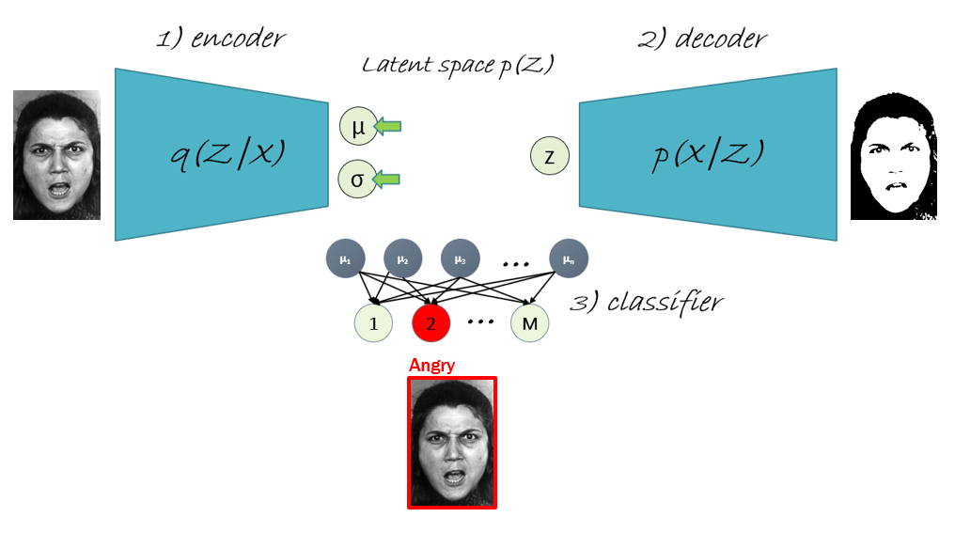
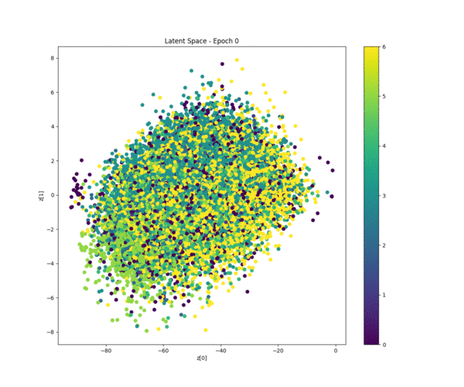
Model 4 Classifier-Conditioned Variational Autoencoder (Architecture)
Hint on the loss function
Reconstruction loss difference of input X vs decoder output X*
KL Divergence loss difference of distribution q(Z|x_{i}) vs prior distribution p(z)
Classifier loss difference between true and predicted labels
Reparameterization Trick
A gaussian variate can be written in the following form
The trick allows backpropagation to flow through the mean and variance nodes
encoder image input >>>
<<< decoder lossy image output
<<< classifier label prediction output

Slide 17
Model 4 Classifier-Conditioned Variational Autoencoder (Classifier and Activation Function)
The classifier architecture
The network is composed of one hidden layer, 256 nodes with adaptive gaussian activation function
The input takes only the n-dimensional means from the latent space
The output layer outputs linear logits to a categorial cross-entropy loss together with the true labels
Adaptable Gaussian Activation Function
The activation parameters are also trained with gradient descent during the network training
Using this function resulted in faster convergence; hence, faster training
The gaussian activation produced better accuracy compared to ReLu and Sigmoid functions, as well as lowe KL-Divergence
μ₁
μ₂
μ₃
…
μ_{n}
Input Layer >>>
3) classifier
…
1
2
M
<<< Class label outputs
Hidden layer activation function >>>

Slide 18
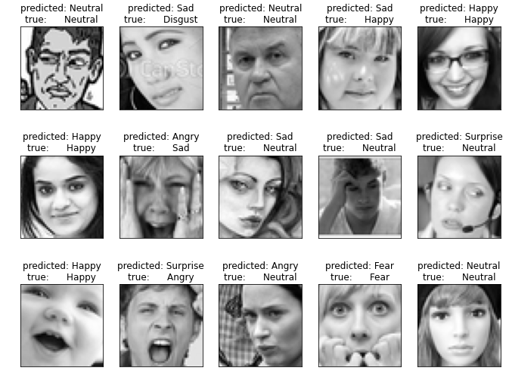
Results Accuracy Summary
After training our models and using them to predict the labels on the Private Test set, we observed that the CVAE and CNN out performed all other models.
We evaluated our models by looking at the confusion matrix for each as well as the classification report and overall accuracies.
>>> Sample Predictions <<<
Model | Accuracy
SVM with Pixels | 55.6%
SVM with Landmarks | 56.3%
XGBoost with Pixels | 59.4%
XGBoost with Landmarks | 57.4%
CNN with Images | 78.9%
CC-VAE with Images | xx.x%

Slide 19
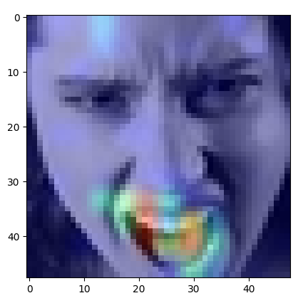
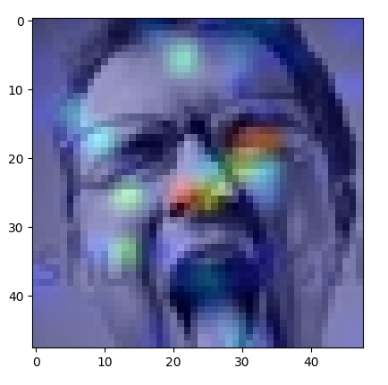
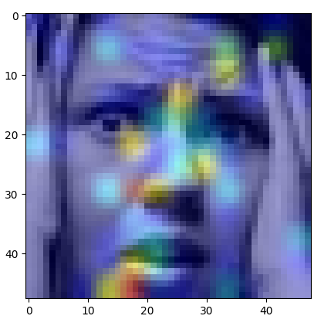
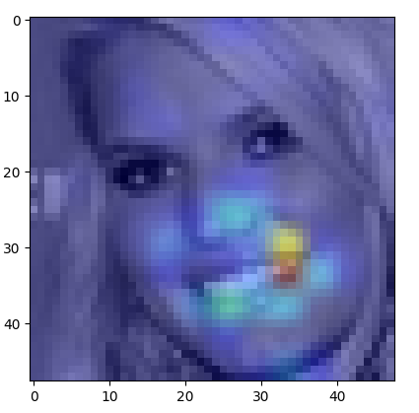
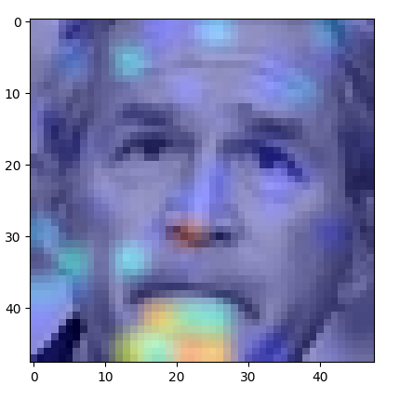
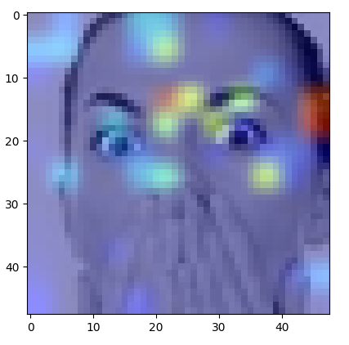
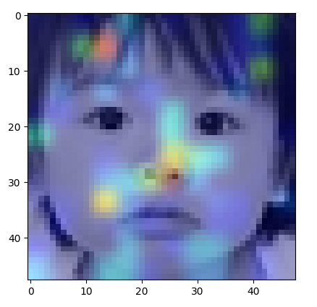
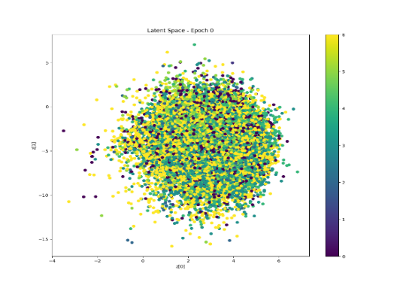
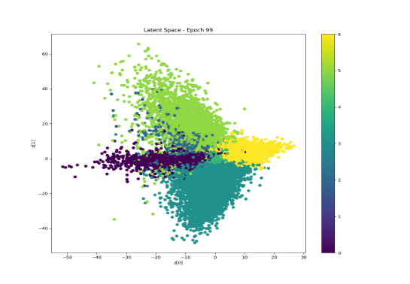
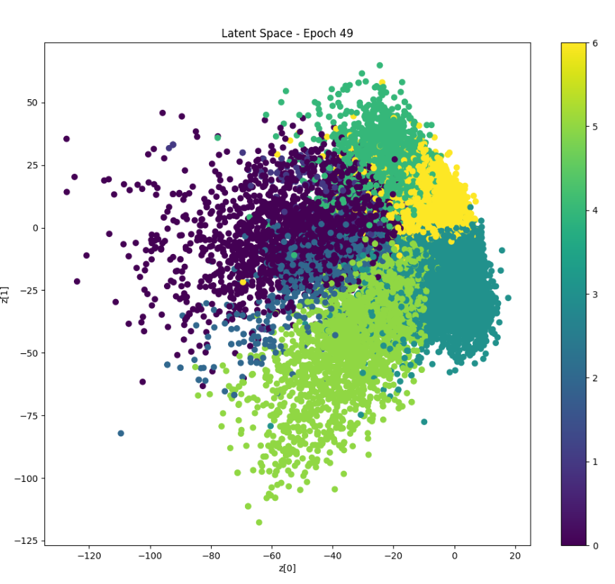
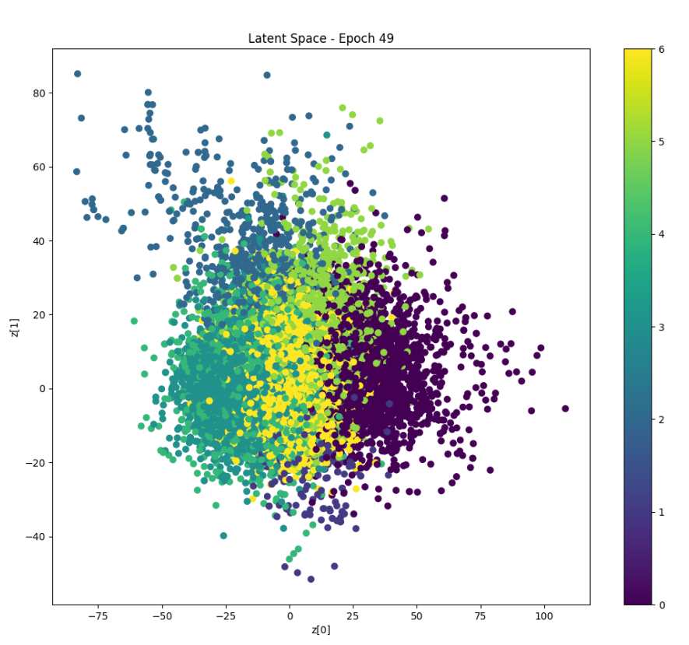
Results The Winners
Not surprising, the CNN outperformed many of the models.
The power of convolutional layers to pic up the underlying feature information in image classification problems in unquestionable.
The CVAE also did a fantastic job of clustering our observations in the latent space allowing us to classify with almost the same precision as the CNN.
Angry Disgust Fear Happy Sad Surprise Neutral
2d
3d
10d

Slide 20
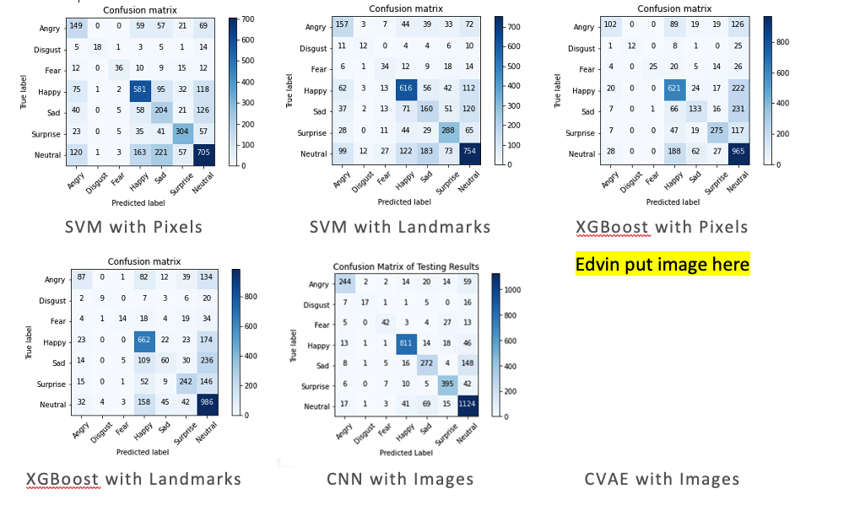
Results Confusion Matrices
When I do the report

Slide 21

Questions?

